Slide 1
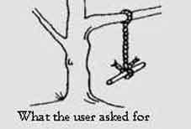
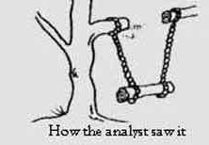
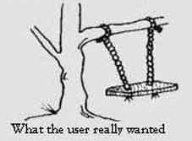
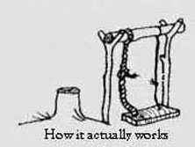
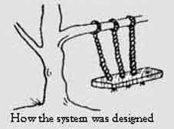
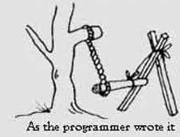
Introduction

Slide 2
Introduction (contd.)
Measurement:
enables objective evaluation
can be applied to improve software process
assists project management
Metrics used to evaluate:
Efficiency
Complexity
Understandability
Reusability
Testability / Maintainability
Notes:
Measurements enables us to evaluate the situation properly.
It can also be applied to improve the software process and hence assist project management
The common measurement entities are the software metrics, which helps us to evaluate :

Slide 3
Introduction (contd.)
Metrics under research consideration:
Cyclomatic code complexity (CCC)
Weighted Methods per Class (WMC)
Depth of Inheritance Tree (DIT)
Number of Children (NOC)
Coupling between Classes (CBC)
Lack of Cohesion in Methods (LCOM)
COCOMO II
Let I_{i} and I_{j} be the set of instance variables accessed by the methods M₁ and M₂, Q be the set of all cohesive pairs of methods, that is, all (M_{i}, M_{j}) such that I_{i} and I_{j} have a non-null intersection. Let P be the set of all non-cohesive pairs of methods, that is, pairs such that the intersection of sets of instance variables they access is null. Then LCOM is defined as
LCOM = |P|-|Q|, if |P| > |Q|
otherwise 0.
Suppose a class C has methods M1, M2... Mn defined on it. Let the complexity of the method M1 be c1, then
WMC =
McCabe's Cyclomatic Complexity is the number of 'linearly independent' paths through the program (or flow graph) and this value is computed using the formula:
v(F) =e-n+2
where n = total number of nodes; e = total number of edges or arcs; and v(F) is the cyclomatic number.

Slide 4
Cyclomatic Complexity:
Cyclomatic complexity Threshold Values | Risk evaluation
01 – 10 | Simple Program, without much risk
11 – 20 | More complex program, moderate risk
21 – 50 | Complex program, high risk
> 50 | Un-testable program, very high risk

Slide 5
Weighted Methods Per Class:
Number of Complex Methods in a class | Effect
High | - Potentially Error Prone - Impact on the children of the class - Reusability decreases
Low | Reusability Increases

Slide 6
Depth of Inheritance Tree [DIT]:
Attribute | Increase ( ↑ ) / Decrease ( ↓ ) Along with increasing DIT
Reusability
Maintainability | ↓
Portability | ↓
Functionality | ↑
Reliability
Efficiency | ↓
Maintainability | ↓

Slide 7
Number of Children [NOC]:
Attribute | Increase ( ↑ ) / Decrease ( ↓ ) along with increasing NOC
Reusability | ↑
Changeability
Portability | ↓
Reliability | ↑
Adaptability | ↓
Maintainability

Slide 8
Coupling Between Classes [CBC]:
CBC Nominal Range | Analysis
0 | a class has no relationship to any other class in the system, not a part of the system
1 – 4 | Good, the class is loosely coupled
> 4 | the class is too tightly coupled, complicated testing and modification, and limited re-use possibilities.

Slide 9
Lack of Cohesion in Methods [LCOM]:
Complexity
( Probable increase in error )
Cohesion in methods

Slide 10
COCOMO (COnstructive COst MOdel) II:
Based on SLOC (source lines of code) characteristic, and operates according to the
following equations:
Effort = PM = Coefficient_{<Effort Factor>}*(SLOC/1000)^P Development time = DM = 2.50*(PM)^T Required number of people = ST = PM/DM where: PM : person-months needed for project SLOC : source lines of code P : project complexity (1.04-1.24) DM - duration time in months for project T : SLOC-dependent coefficient (0.32-0.38) ST : average staffing necessary
Software Project Type | Coefficient_{<Effort Factor>} | P | T
Organic | 2.4 | 1.05 | 0.38
Semi-detached | 3.0 | 1.12 | 0.35
Embedded | 3.6 | 1.20 | 0.32

Slide 11
THE END

Slide 12
Depth of Inheritance Tree (DIT)
The deeper a particular class is in a class hierarchy, the more methods it has available for reuse, thereby providing a larger reuse potential
Inheritance increases coupling, which makes changing a class harder
A class deep in the hierarchy has a lot of methods it can inherit, which makes it difficult to predict its behavior
The DIT of a class C in an inheritance hierarchy is the depth from the root class in the inheritance tree
It is the length of the shortest path from the root of the tree to the node representing C or the number of ancestors C has
In case of multiple inheritance, the DIT metric is the maximum length from a root to C
Statistical data suggests that most classes in applications tend to be close to the root, with the maximum DIT metric value being around 10
Most the classes have a DIT of 0 (that is, they are the root).
The designers tend to keep the number of abstraction levels (reflected by the levels in the inheritance tree) small, presumably to aid understanding. In other words, designers might be giving upon reusability in favor of comprehensibility
The experiments show that DIT is very significant in predicting defect-proneness of a class: the higher the DIT the higher is the probability that the class is defect-prone

Slide 13
Number of Children (NOC)
The number of children (NOC) metric value of a class C is the number of immediate subclasses of C
This metric can be used to evaluate the degree of reuse, as a higher NOC number reflects reuse of the definitions in the superclass by a larger number of subclasses
It also gives an idea of the direct influence of a class on other elements of a design
The larger the influence of a class, the more important the class is correctly designed
In the empirical observations, it was found that classes generally had a small NOC metric value, with a vast majority of classes having no children
This suggests that in the systems analyzed, inheritance was not used very heavily
The data suggest that the larger the NOC, the lower the probability of detecting defects in a class
The higher NOC classes are less defect-prone. The reasons for this are not very clear or definite.

Slide 14
Coupling between Classes (CBC)
Coupling between classes of a system reduces modularity and make class modification harder
It is desirable to reduce the coupling between classes
The less coupling of a class with other classes, the more independent the class, and more easily modifiable
Coupling between classes (CBC) is a metric that tries to quantify coupling that exists between classes
The CBC value for a class C is the total number of other classes to which the class is coupled
Two classes are considered coupled if methods of one class use methods or instance variables defined in the other class
There are indirect forms of coupling (through pointers, etc.) that are hard to identify
The experimental data indicates that most of the classes are self-contained and have low CBC value.
Some types of classes, for example the ones that deal with managing interfaces, generally tend to have higher CBC values
The data found that CBC is significant in predicting the fault-proneness of classes, particularly those that deal with user interfaces.

